Slide 1
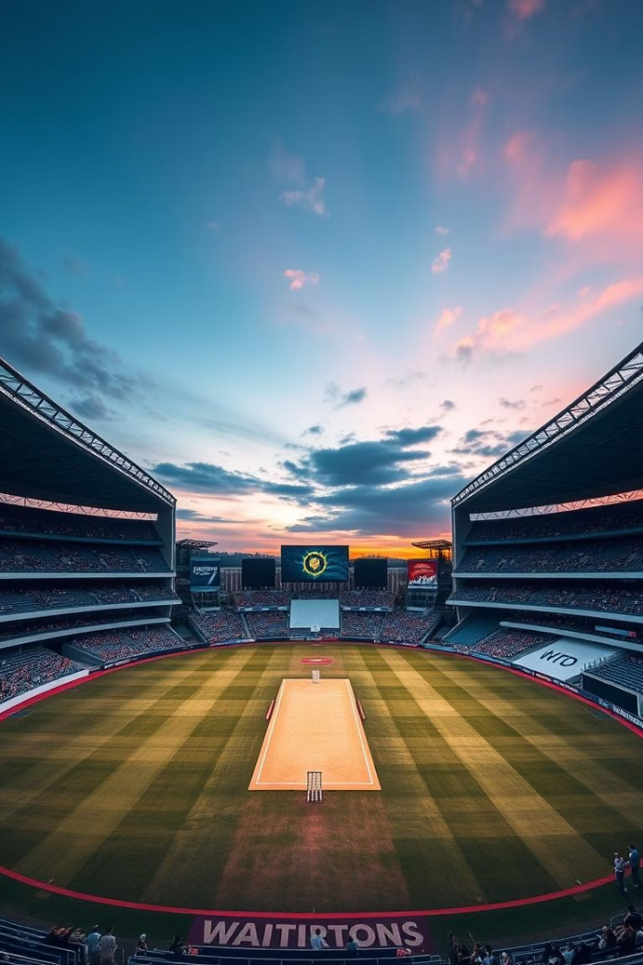


IPL Analysis 2021-2023
An in-depth analysis of the Indian Premier League
from 2021 to 2023.
Present by :
V Arun Kumar

Slide 2
Agenda
1
IPL Hsitory
2
Problem Statement
About IPL details and history.
About this Project
3
Project Overview
4
Insights
Outline the project's objectives and data.
Analyze key Insights.
5
Dashboard Showcase
Present a visual dashboard of key performance indicators.

Slide 3

IPL History
Started in 2008
Most Successful Teams
The Indian Premier League (IPL) was launched in 2008 by the Board of Control for Cricket in India (BCCI).
CSK & MI Have each won IPL
5 titles.
Season Duration
Format
It's a T20 (Twenty20) cricket league with
franchise-based teams playing
Held annually between March and May,
lasting about 2 months.
Team Ownership
Global Popularity
Teams are owned by corporate houses,
celebrities and business tycoons
IPL is one of the richest and most-watched
cricket leagues globally, broadcast in over
120 countries.

Slide 4
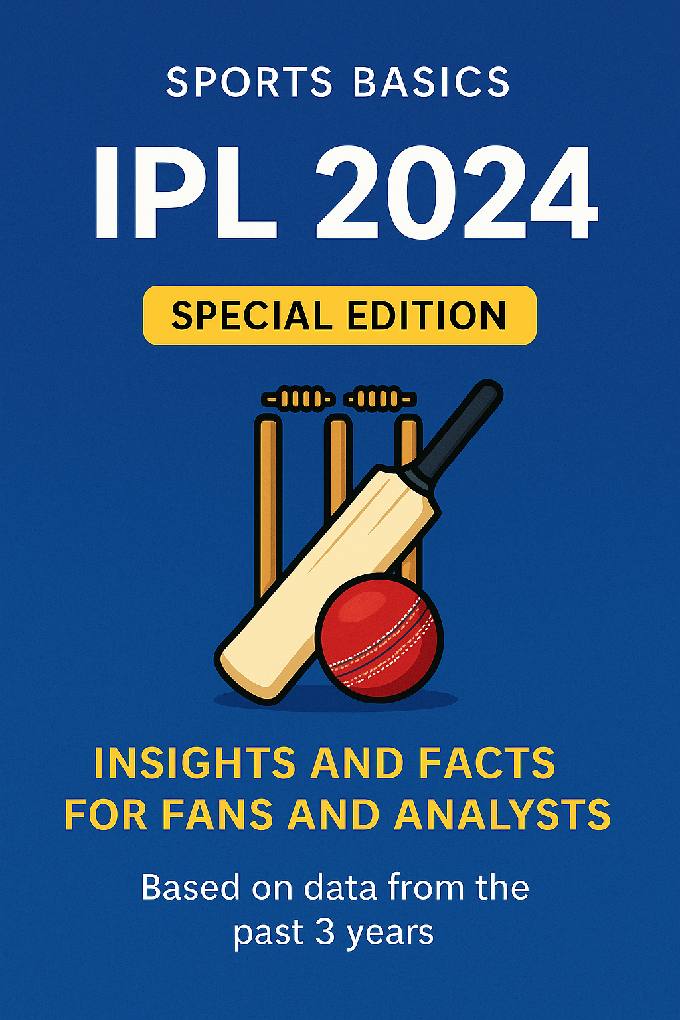
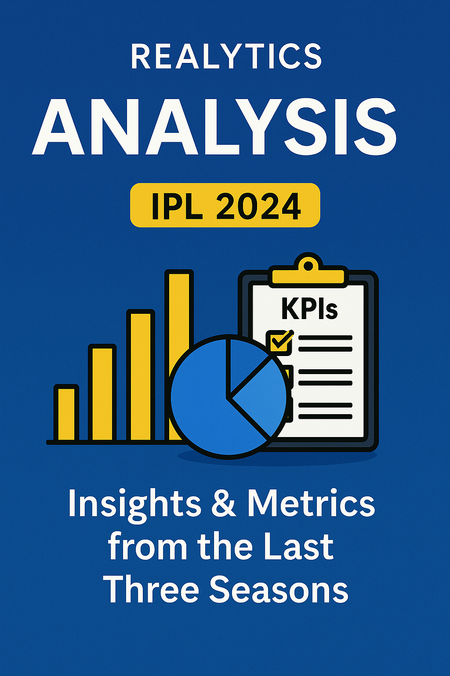
Problem Statement
"Sports Basics" is a sports blog company that entered space recently.
They wanted to get more traffic to their website by releasing a special edition magazine
on IPL 2024.
This magazine aims to provide interesting insights and facts for fans, analysts and
teams based on the last 3 years' data.

Slide 5
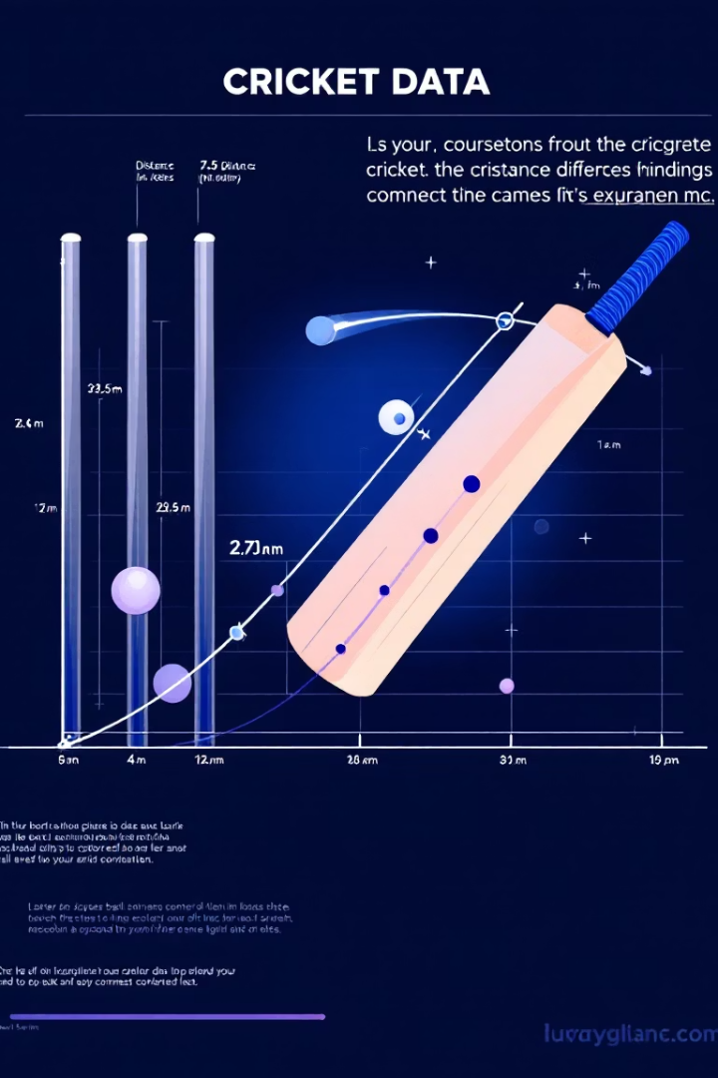




Project Overview
Objective
Get insights based on Primary and Secondary Analysis
Focus
Analyze batting, bowling and team performance.
Datasets
Use dim_match_summary, dim_players, fact_batting_summary, and fact_bowling_summary.
Data Techniques
Data cleaning, validation, removing duplicates and spaces.

Slide 6
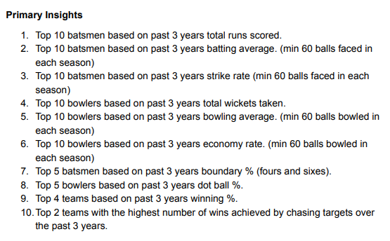
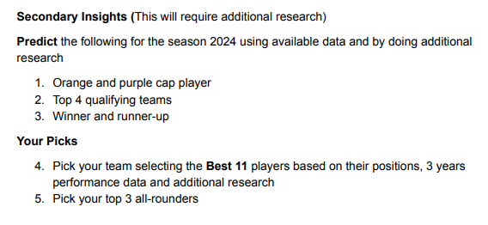
Primary & Secondary Insights
Primary Insights
Secondary Insights
Key observations from initial data exploration.
Detailed analyses and observations based on primary insights.

Slide 7
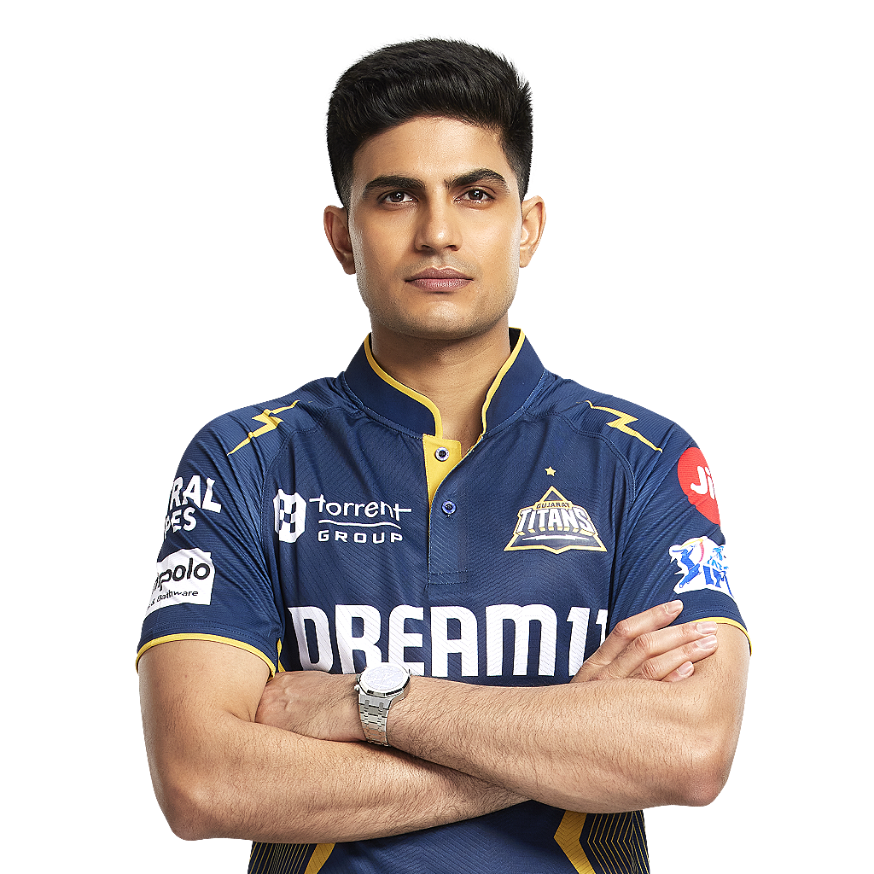
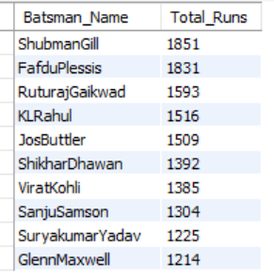
Primary INSIGHTS FOR BATSMEN
Minimum 60 Balls Faced in Each Season
Top 10 batsmen based on past 3 years total runs scored
ShubhmanGill (1851 – Runs)

Slide 8
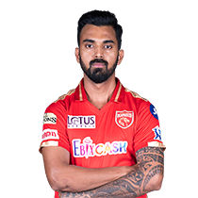
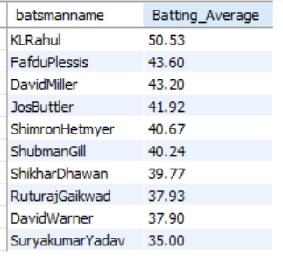
Primary INSIGHTS FOR BATSMEN
Minimum 60 Balls Faced in Each Season
Top 10 batsmen based on past 3 years batting average
KL Rahul (50.53 – Batting Average)

Slide 9
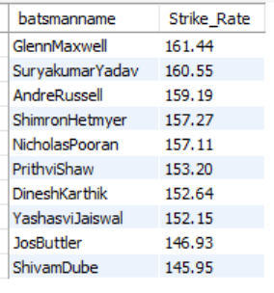
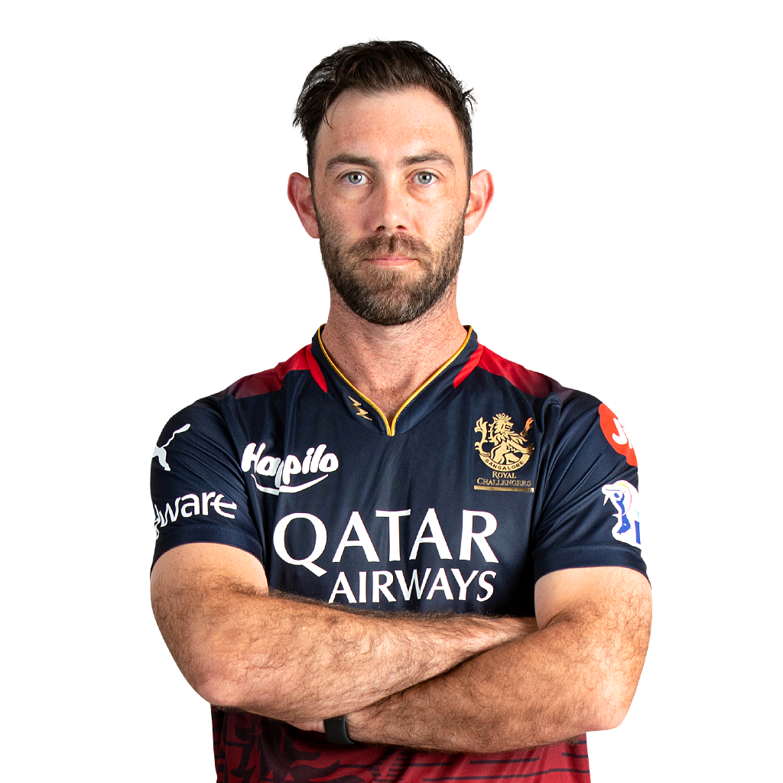
Primary INSIGHTS FOR BATSMEN
Minimum 60 Balls Faced in Each Season
Top 10 batsmen based on past 3 years strike rate
Glen Maxwell (161.43 – Strike Rate)

Slide 10
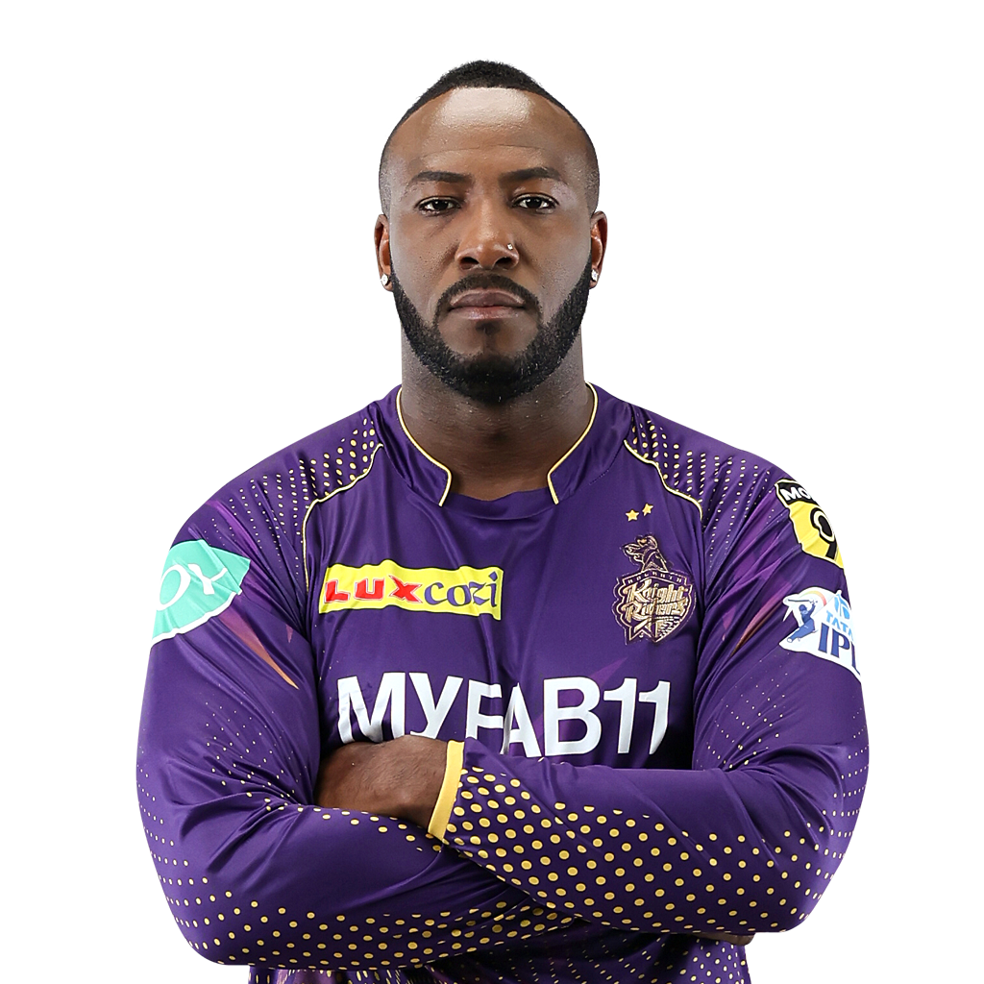
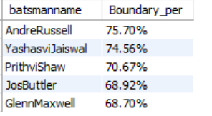
Primary INSIGHTS FOR BATSMEN
Minimum 60 Balls Faced in Each Season
Top 5 batsmen based on past 3 years boundary %
Andre Russell (75.70% - Boundary%)

Slide 11
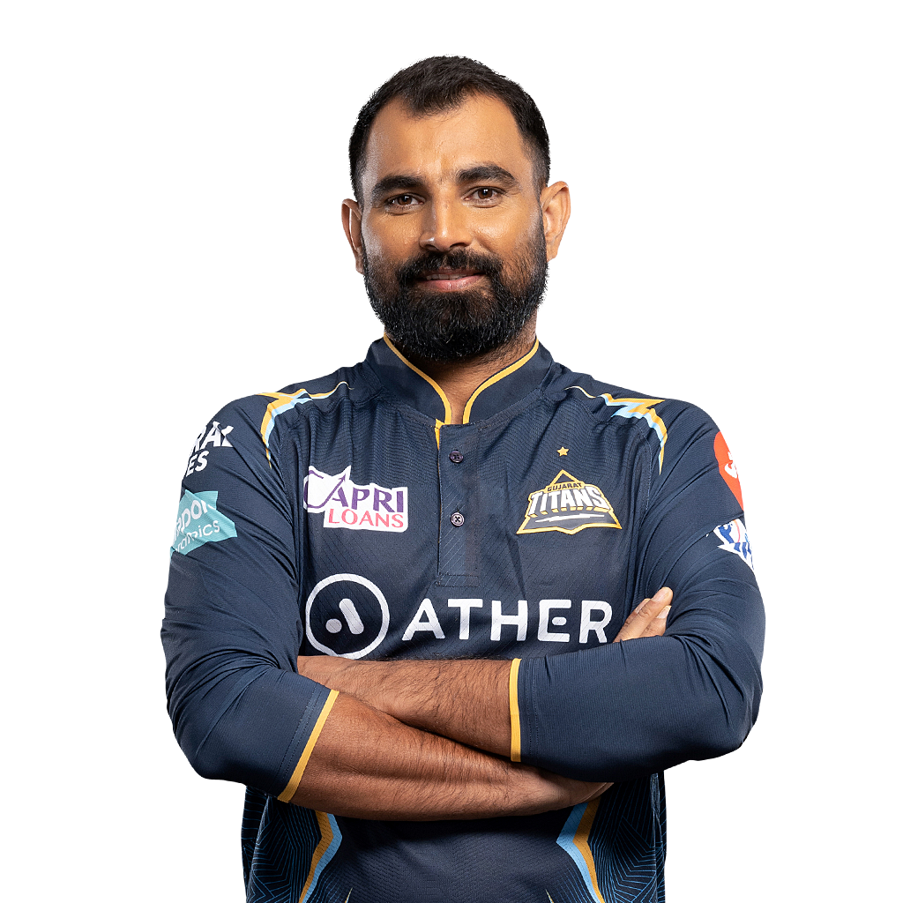
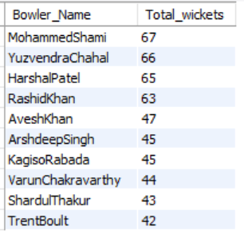
Primary INSIGHTS FOR BOWLERs
Minimum 60 Balls Bowled in Each Season
Top 10 bowlers based on past 3 years total wickets taken
MohammedShami (67 – Wickets)

Slide 12
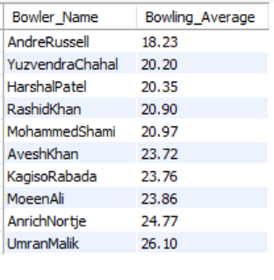
Primary INSIGHTS FOR BOWLERS
Minimum 60 Balls Bowled in Each Season
Top 10 bowlers based on past 3 years bowling average
Andre Russell (18.23 – Bowling Average)

Slide 13
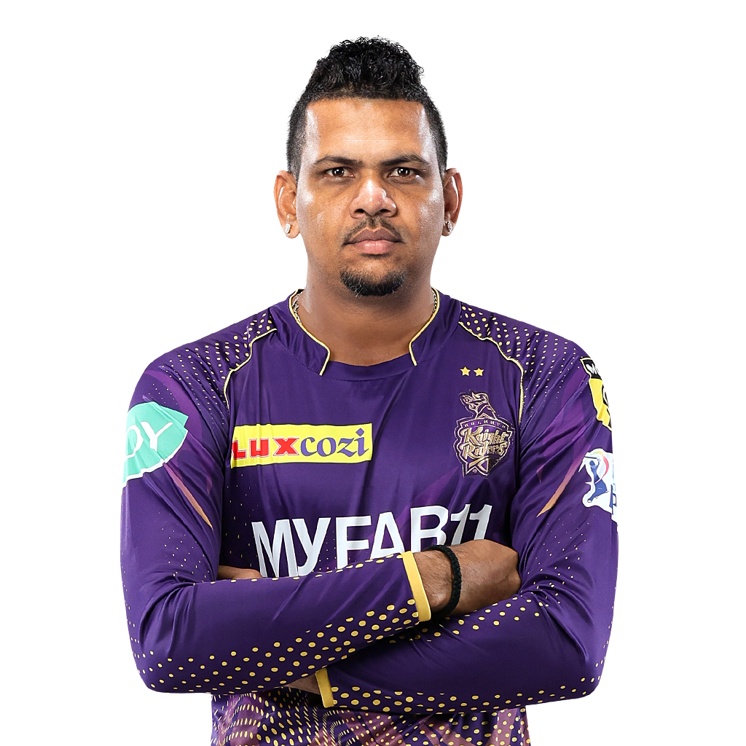
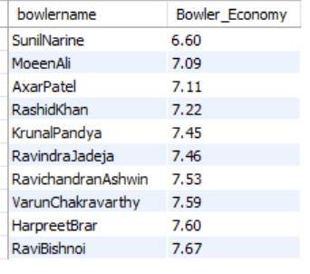
Primary INSIGHTS FOR BOWLERS
Minimum 60 Balls Bowled in Each Season
Top 10 bowlers based on past 3 years economy rate
Sunil Narine (6.60 – Economy)

Slide 14
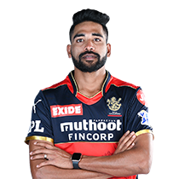
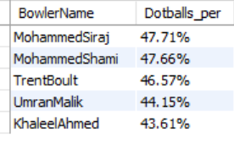
Primary INSIGHTS FOR BOWLERS
Minimum 60 Balls Bowled in Each Season
Top 5 bowlers based on past 3 years dot ball %.
Mohammed Siraj (47.71% - Dot Ball %)

Slide 15


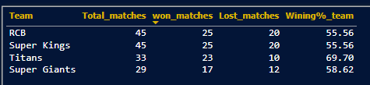

Primary INSIGHTS by teams
Top 4 teams based on past 3 years winning %

Slide 16


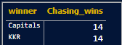
Primary INSIGHTS by teams
Top 2 teams with the highest number of wins achieved by chasing targets over the past 3 years.

Slide 17
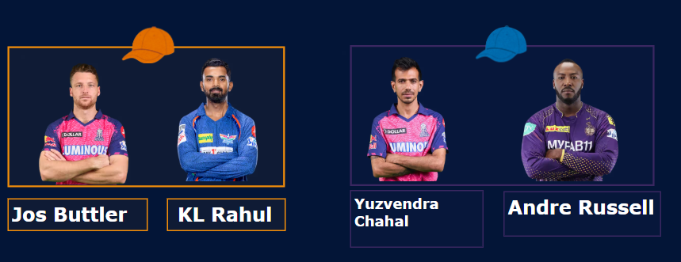
SECONDARY INSIGHTS
Orange & purple cap player ( Prediction)

Slide 18
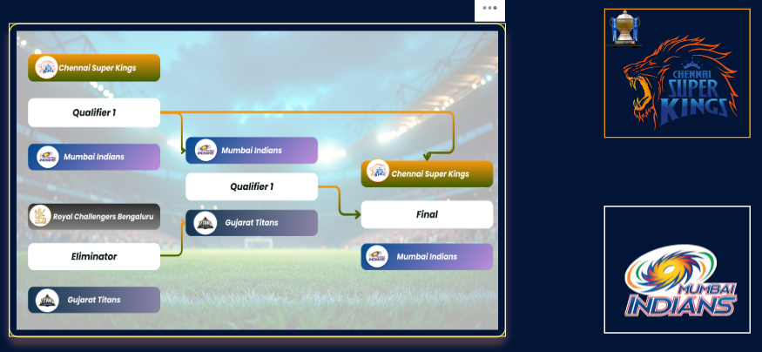
SECONDARY INSIGHTS
Top 4 qualifying teams & Winner and runner-up

Slide 19
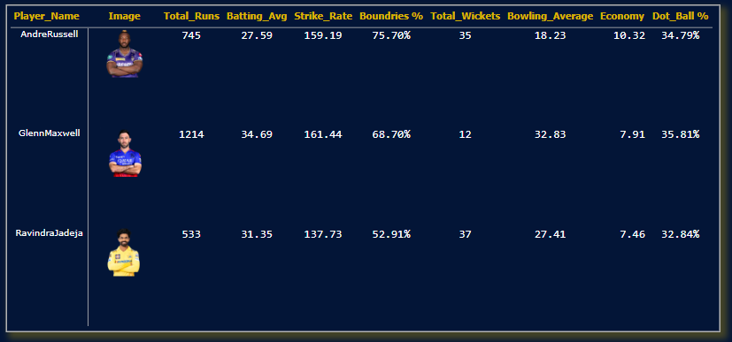
SECONDARY INSIGHTS
Pick your top 3 all-rounders

Slide 20
Dashboard showcase
Click Here to Dashboard

Slide 21


SPECIAL THANKS TO
HEMANAND SIR
DHAVAL PATEL SIR

